Slide 1

GANdinsky
Course: Neural Networks & Deep Learning
Instructor: Dr. Farid Alizadeh
Group Members: Elnaz Asghari, Ruiwen Zhang, Sunit Nair

Slide 2
Contents
Introduction
01
Project scope and limitations
Generative Adversarial Networks
02
Introduction to the concept of GAN and overview
Project architecture
03
Architecture, libraries, and tools used
Results
04
Generated images and future work
References & Conclusion
05
Datasets, GitHub etc.

Slide 3
Introduction
01
Project scope
Create a Generative Adversarial Network to create art from portrait and abstract datasets.
Set up project to read data from Google Drive and save output to Google Drive.
Compress raw dataset into readable and reusable files.
Extended scope: explore additional types of GAN (WGAN/DCGAN)
Limitations
Objective evaluation of model is difficult compared to classification/regression problems.
Good results require large number of epochs and/or complex modeling.
Long session running times and limitations on hardware availability (Colab Pro).
Subjective nature and interpretation of “art”.
More about this in the next slide.
Definition of art
For the purpose of this project, any image generated that resembles the style of the dataset to a recognizable degree without introducing overfitted elements or blatant patterns is considered generated art.

Slide 4

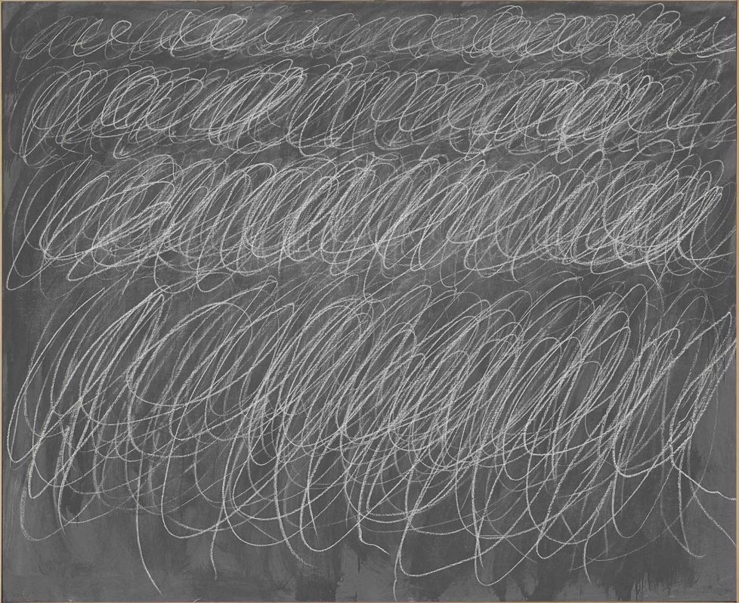
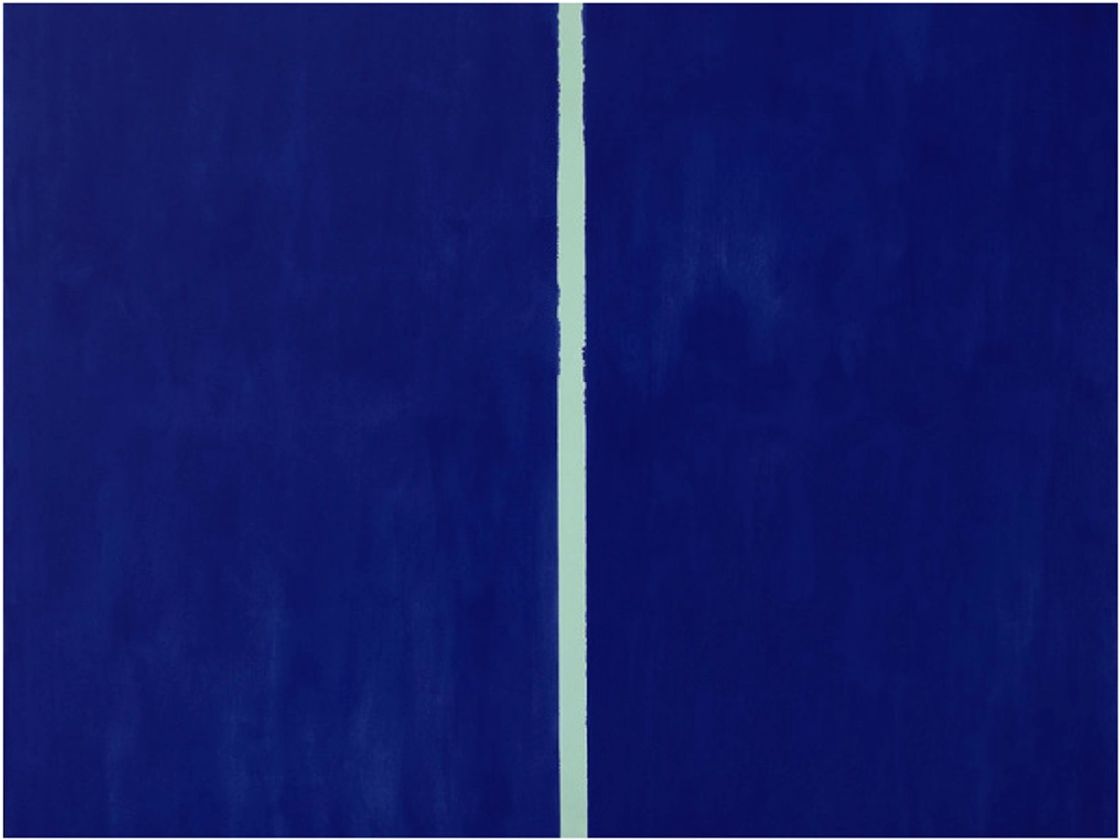
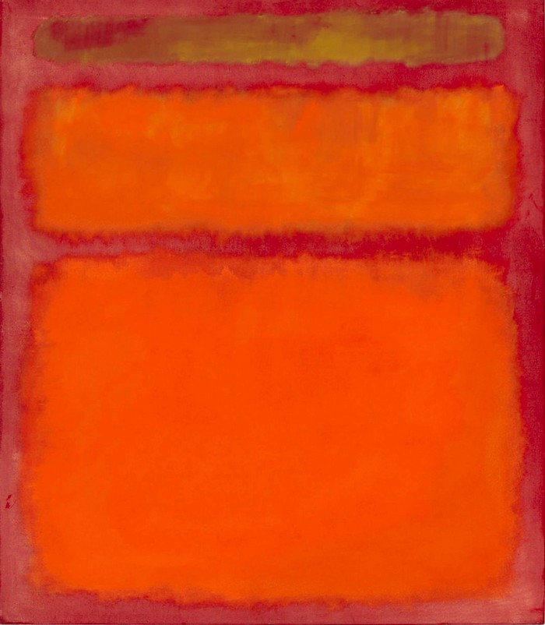
Introduction
01
Subjective nature of art
The blood-red mirror
by Gerhard Richter
$1.1 million
Untitled
by Cy Twombly
$2.3 million
Onement VI
by Barnett Newman
$43.84 million
Orange, Red, Yellow
by Mark Rothko
$86 million
Another reason for this might be the controversial status quo of the “art world” as explained in this video.
Source: iloboyou.com

Slide 5
Generative Adversarial Networks
02
Definition
Generative Adversarial Networks (GANs) are algorithmic architectures that use two neural networks,
pitting against the other (thus the “adversarial”) in order to generate new, synthetic instances of data
that can pass for real data.
History
GANs were introduced in a paper by Ian Goodfellow and other researchers at the University of Montreal,
including Yoshua Bengio, in 2014.
Applications
Widely used in the generation of images, video, and voice.
Some types of GANs
Deep Convolutional GANs (DCGANs)
Conditional GANs (cGANs)
StackGANs
InfoGANs
Wasserstein GANs (WGANs)

Slide 6
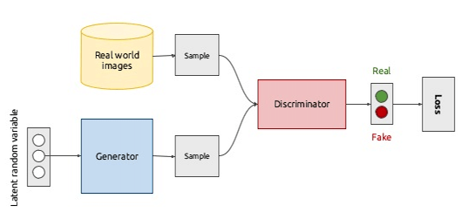
Generative Adversarial Networks
02
Architecture: Generative vs Discriminative Networks
Source: mc.ai
Discriminative Network
Tries to classify input data. Given the features of an instance of data, predict a label or category to which it belongs. In this instance, differentiate between a real and fake painting.
Generative Network
Attempt to predict features given a certain label or category to which that data belongs.
These opposing objectives and competition between the two networks is the hallmark of GANs.

Slide 7
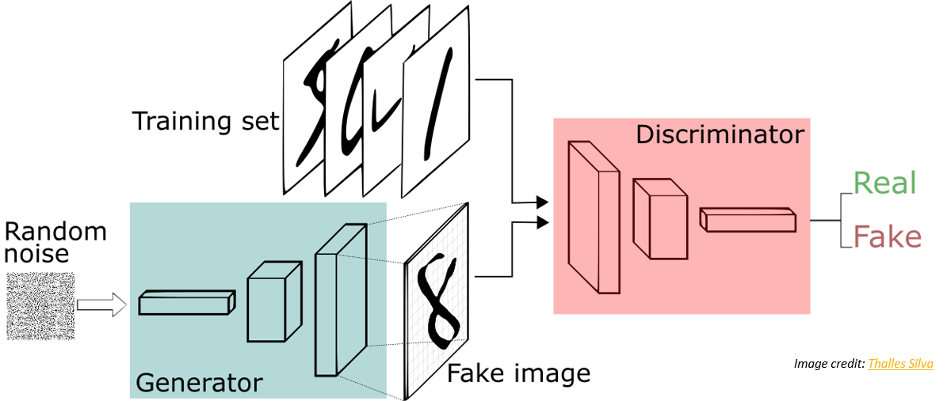
Generative Adversarial Networks
02
How GANs work
The generator generates and returns an image
The generated image is fed into the discriminator alongside a stream of images taken from the actual dataset
The discriminator takes in both real and fake images and returns probabilities
Source: medium.com

Slide 8
Project Architecture
03
Python Libraries Used
Platforms/IDEs used
Keras, numpy, Pillow (PIL), google.colab, time, os
Google Colaboratory
Spyder
Configurable Parameters
No. of images to preview, no. of epochs after which to preview, noise size, epochs, batch size, generated resolution, image size
Input
Output
Image dataset resized to 128 x 128 and compressed into a single .npy file
Generated images in grid
Model state and weights in .h5 files at completion

Slide 9
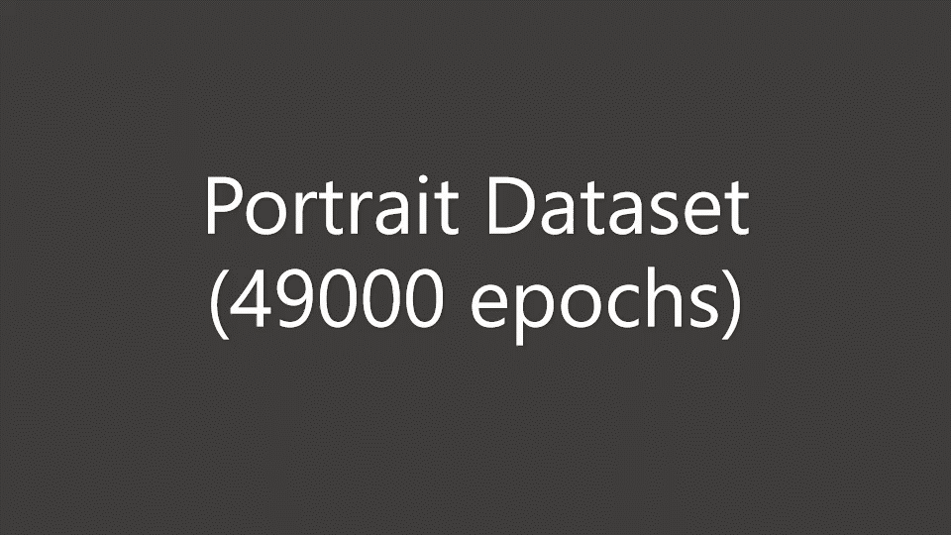
Results
04
Progress visualization : Portrait dataset (6000 images)

Slide 10
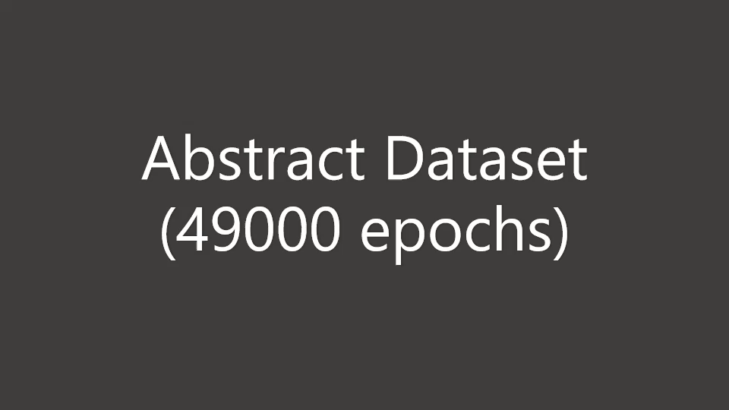
Results
04
Progress visualization : Abstract dataset (6383 images)

Slide 11
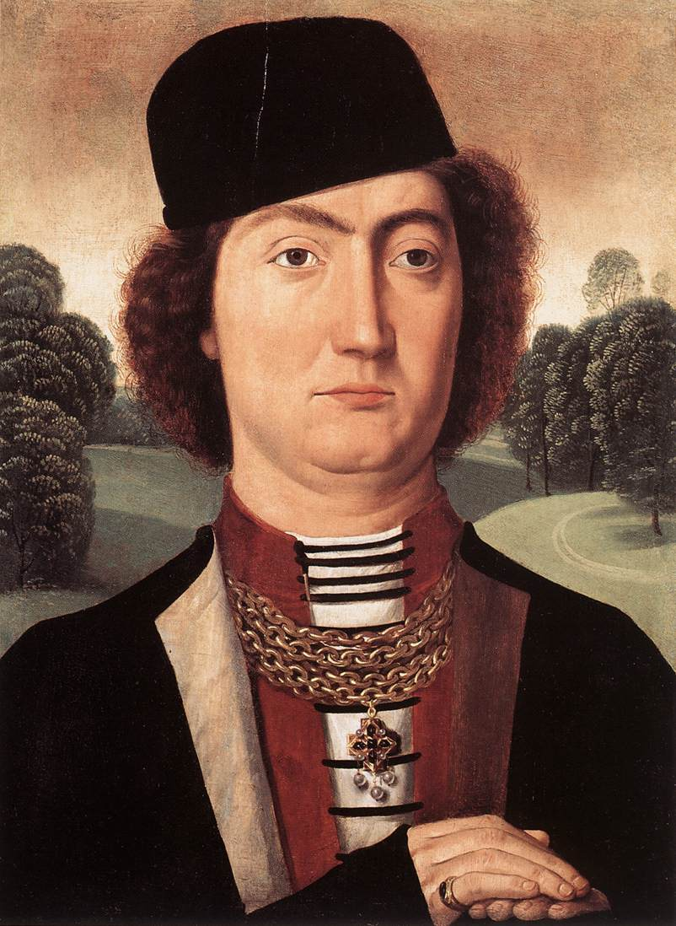
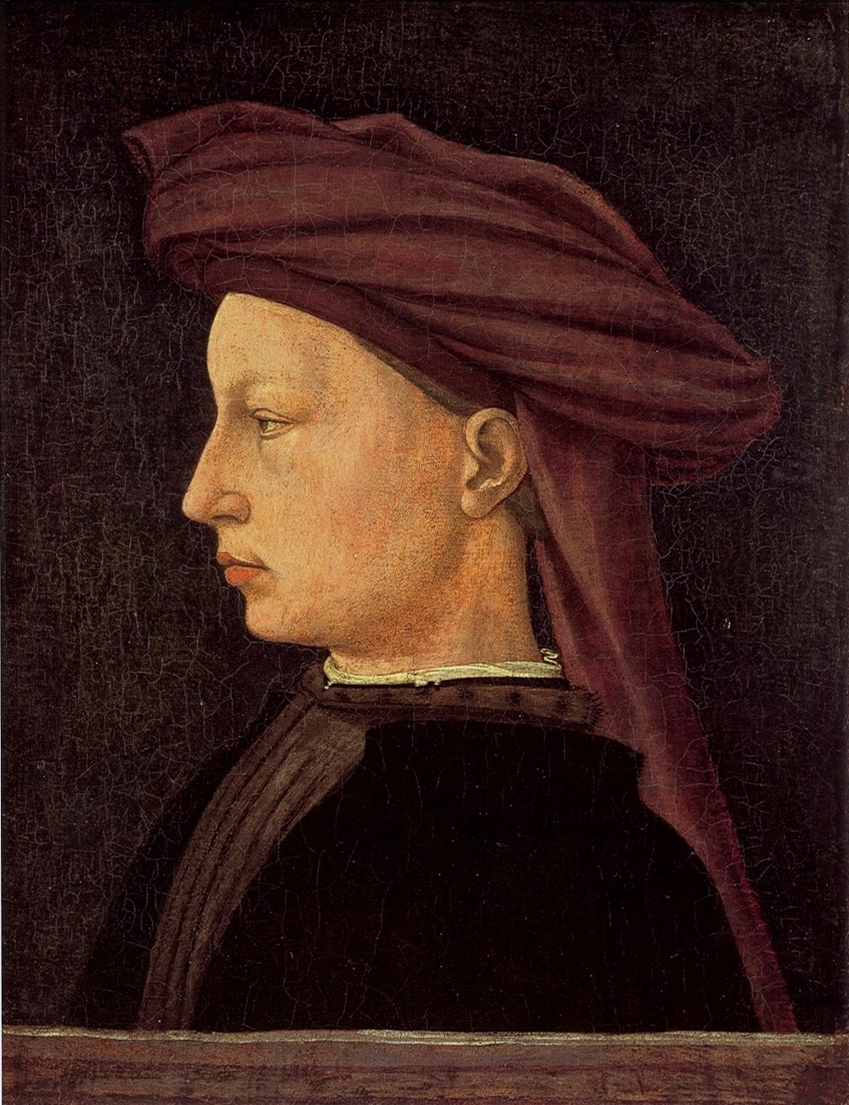
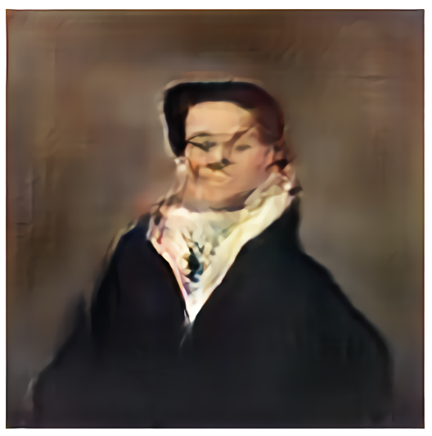
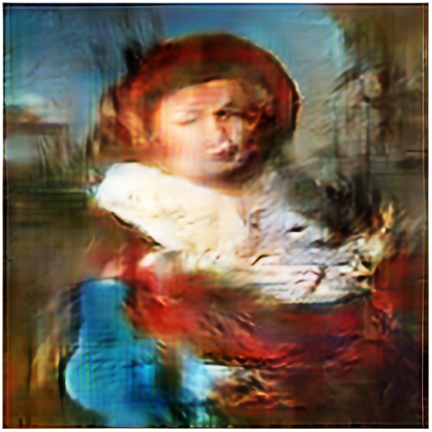
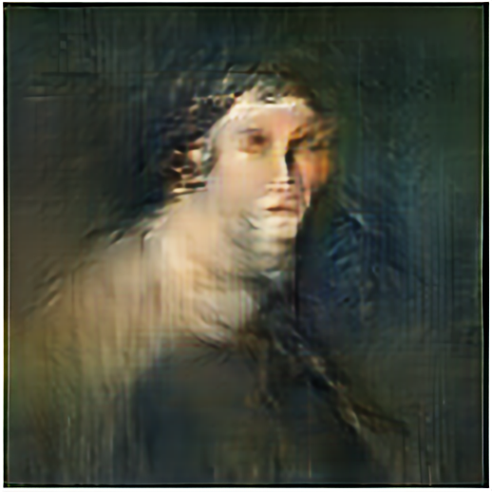
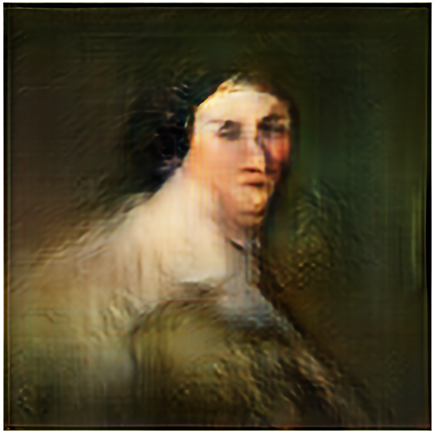
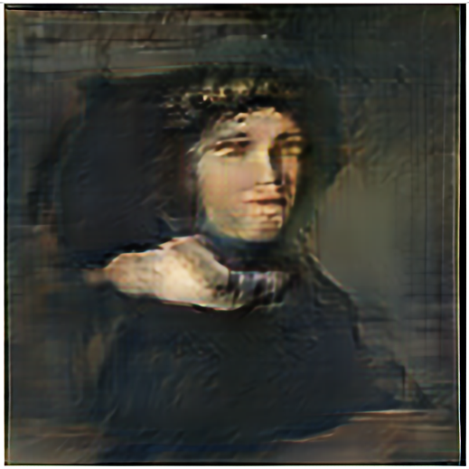
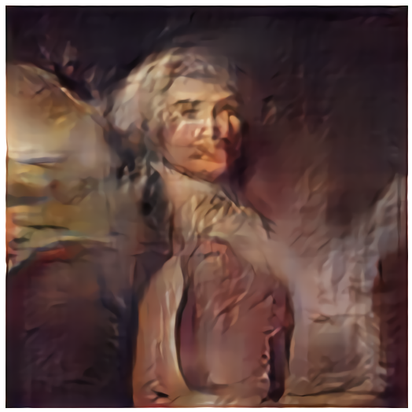
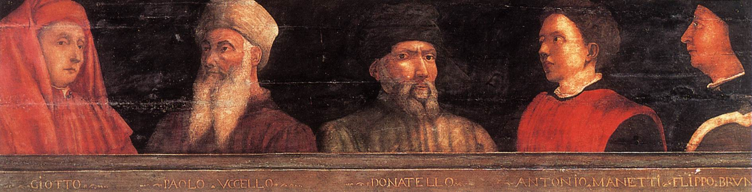
Results
04
Results 1: Portrait dataset (6000 images)
Sample images from dataset (input)
Sample images from results (output)

Slide 12
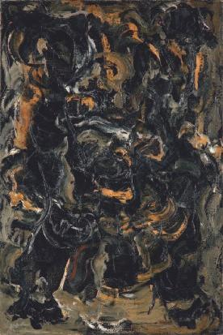
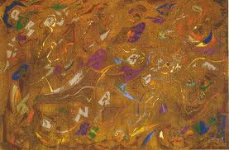
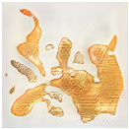
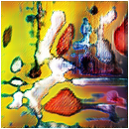
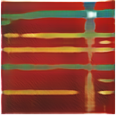
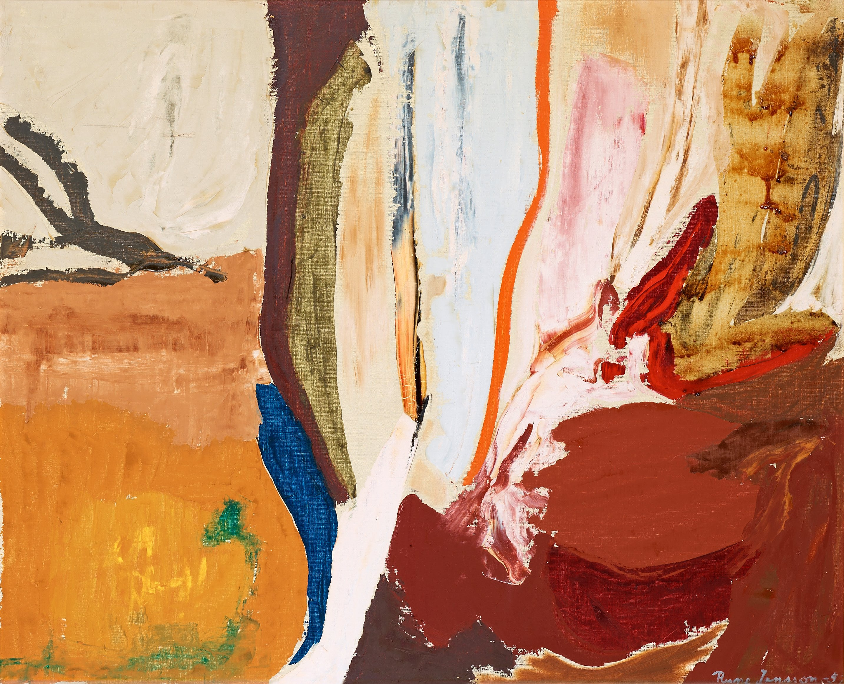
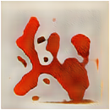
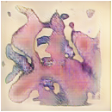
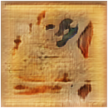
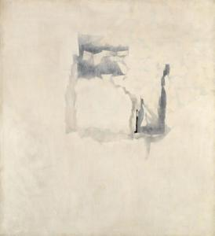
Results
04
Results 2: Abstract dataset (6383 images)
Sample images from dataset (input)
Sample images from results (output)

Slide 13

Wasserstein GAN
05
Two properties (quoted from the paper):
A meaningful loss metric that correlates with the generator’s convergence and sample quality
Improved stability of the optimization process
Wasserstein loss:
- $\frac{1}{n}$ $\sum_{i=1}^{n}{(yipi)}$

Slide 14
References
05
Datasets
WikiArt.org
Repository on Google Drive sourced from GitHub
Repositories
GitHub: nndl-groupc/gandinsky
Google Drive
Online Resources Used
https://towardsdatascience.com/
https://heartbeat.fritz.ai/
https://medium.com/

Slide 15
Conclusions
05
Possible refinements and future work
Build more complex discriminator and generator models
Rent hardware (Amazon EC2) to run more epochs
Use larger datasets (9000+ images)
Larger input and output resolutions (256 x 256)
Potential
AI art sold for $432,500
A trend is emerging with AI generated content being sold as art
GANs and their creative applications have expanded the applications of AI from problem solving to creativity and artistic cases

Slide 16
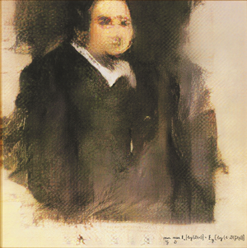
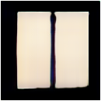
Conclusions
05
Comparing GANdinsky to AI generated and human art
Edmond de Belamy portrait_epoch_46000[0,1] Onement VI abstract_epoch_19000[2,6]
by French art collective Obvious by GANdinsky by Barnett Newman by GANdinsky
$432,500 $43.84 million

Slide 17
Thank You

